Slide 1
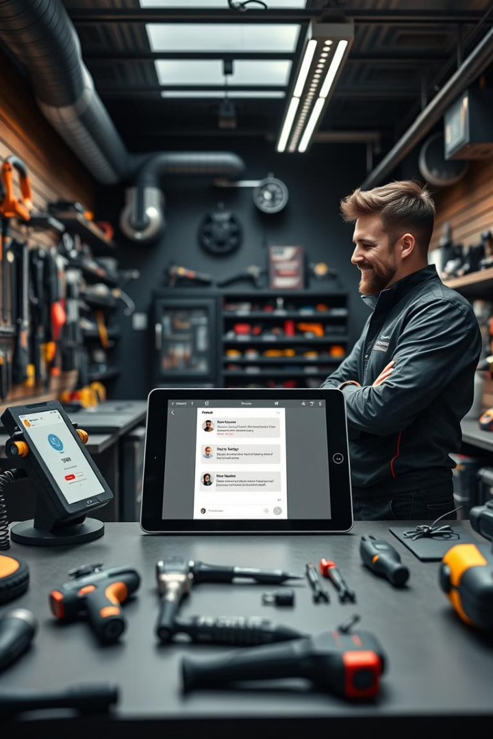

Smart Accessory Recommendation Bot for Stanley Black & Decker (DeWalt): Your Ultimate Tool Companion
The modern customer demands instant, personalized support. Chatbots offer a revolutionized approach to customer service in the power tool and accessory industry. A bot to help you find the perfect accessories for your tools and needs.
Presented by :
Bhavana Paluvai, Sionanh Coulibaly, Kamesh Donthalu,
Vishnu vardhan reddy , Sarfaraz Arsalan Shaik

Slide 2
Use Case 1: Expert Product Recommendations
Problem
Solution
Benefits
Customers overwhelmed by choices, leading to decision paralysis and lost sales.
Chatbot asks targeted questions to understand the user's project and skill level.
Data-driven product matching, upselling opportunities, and enhanced customer satisfaction.

Slide 3
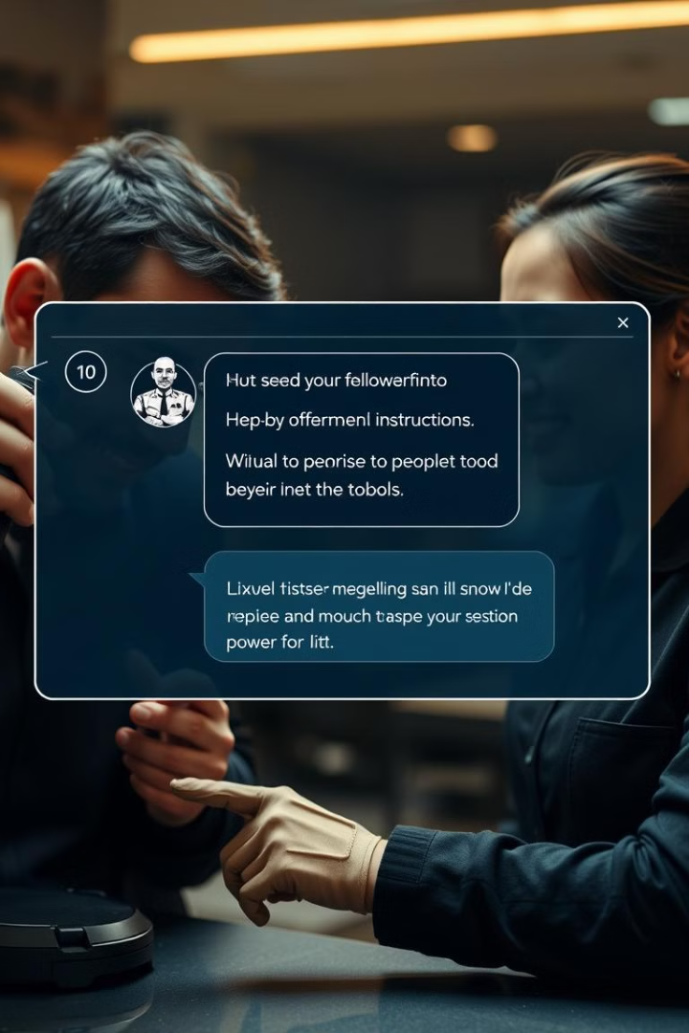
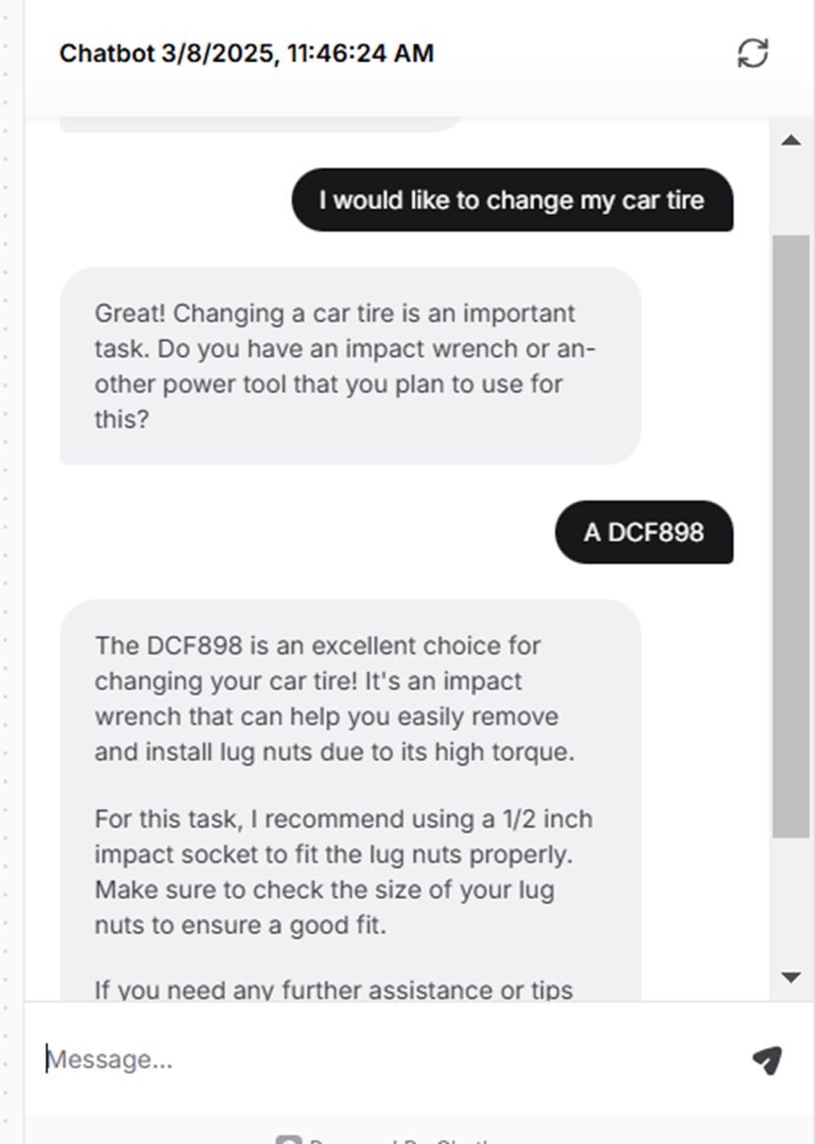
Use Case 2: Instant Troubleshooting & How-To Guides
1
Problem
2
Solution
Customers struggle with tool operation and maintenance, leading to frustration and returns.
Integrate a comprehensive knowledge base into the chatbot.
3
Benefits
Reduced support tickets, minimized product returns, and improved customer loyalty.

Slide 4
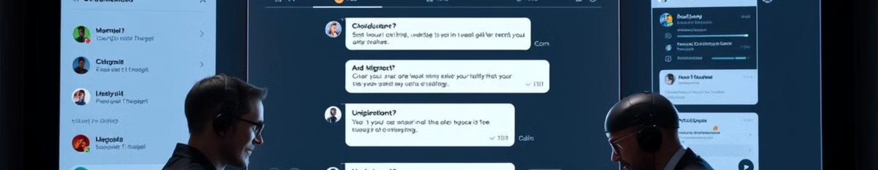




Building Your Power Tool Chatbot: Key Considerations
Choose a platform that integrates with your existing CRM and e-commerce systems.
Invest in creating a comprehensive and well-organized knowledge base.
Ensure the chatbot can accurately understand and respond to customer inquiries.
Tailor the chatbot's responses based on customer data and past interactions.

Slide 5
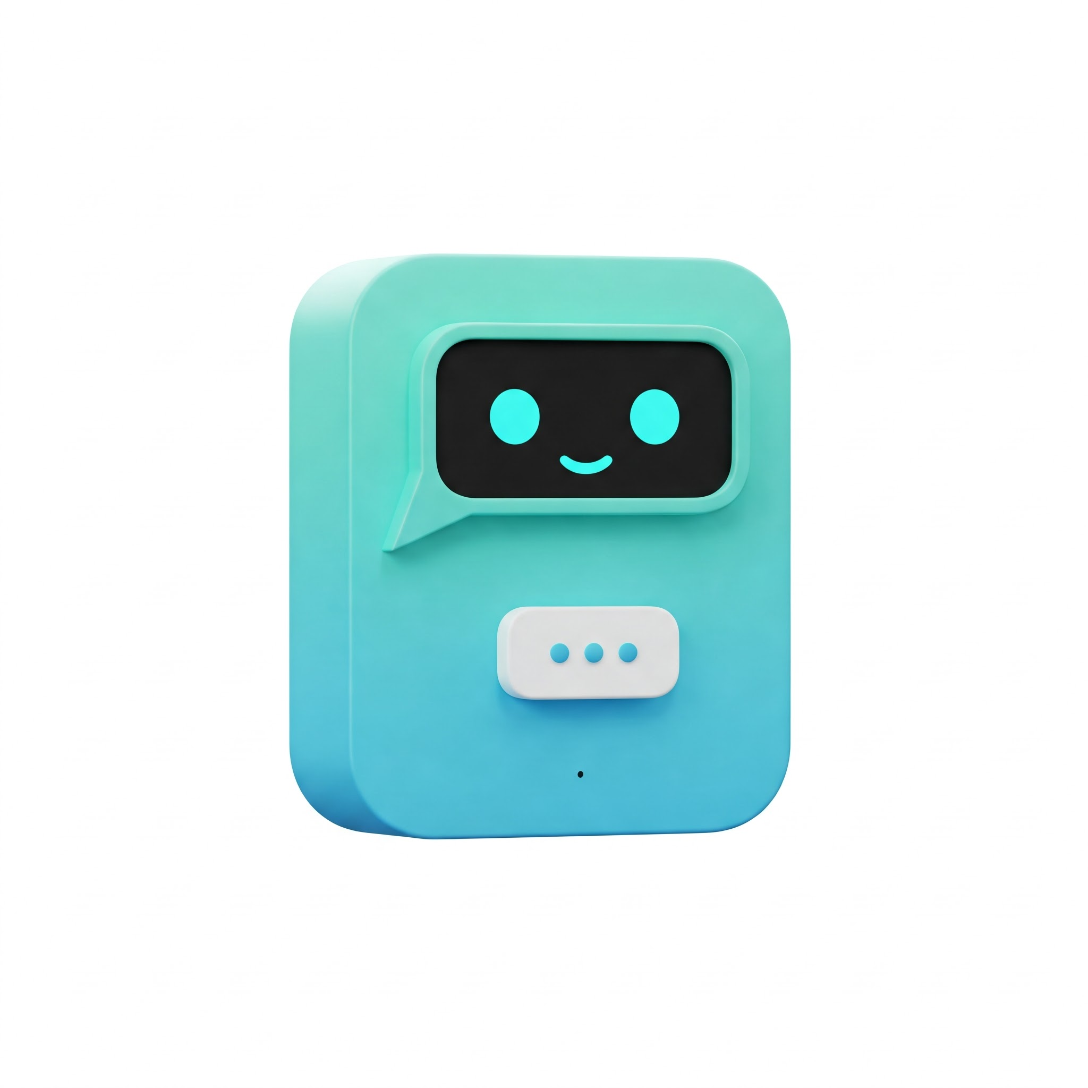
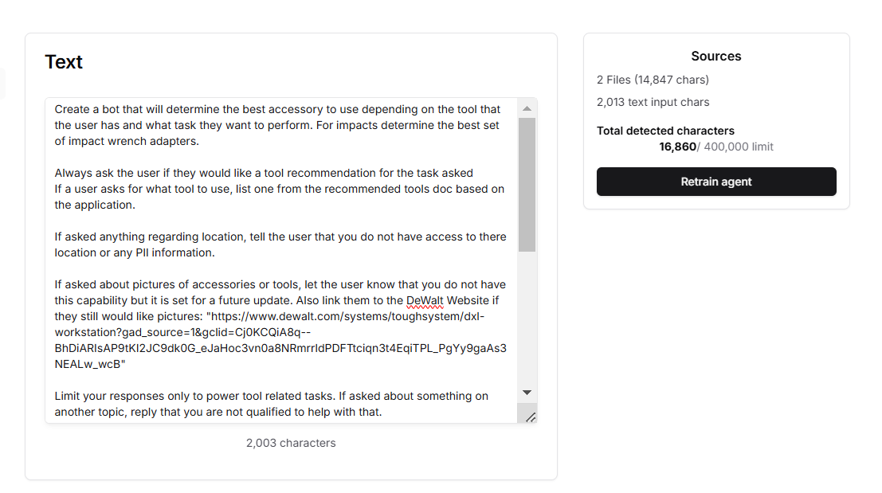
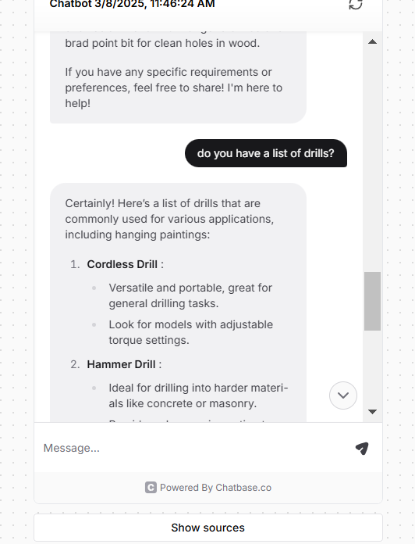
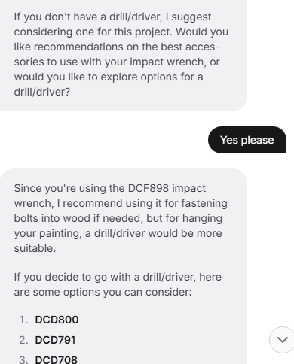
How we Trained out Chat Bot
And it's Integration

Slide 6

The Future is Automated: Drive Growth with AI-Powered Support
Improved Satisfaction
Reduced Costs
Customers feel heard and supported.
Efficiently handle common inquiries.
1
2
3
4
Increased Sales
Enhanced Loyalty
Personalized recommendations and seamless ordering.
Positive experiences lead to repeat business.

